Slide 1

Establishing a Just, Learning Culture Module 9 Chelsea Hefferin

Slide 2

Introduction
A 'Just Culture' balances accountability with learning. It recognizes human error while promoting transparency, trust, and continuous improvement. Despite its benefits, organizations often face significant barriers to adopting it.

Slide 3

Cultural Resistance
One of the largest challenges is the fear of change. Many organizations are accustomed to blame-based cultures. Shifting to a just culture requires altering long-standing behaviors and leadership mindsets.

Slide 4
Lack of Leadership Support
Without visible and consistent support from leadership, efforts to implement a just culture often fail. Leaders must model transparency and learning behaviors to set the tone for the organization.

Slide 5

Misunderstanding of Just Culture
Some teams interpret just culture as no accountability at all. In reality, just culture requires distinguishing between honest mistakes, risky behaviors, and reckless actionseach with appropriate responses.

Slide 6
Poor Communication & Psychological Safety
If employees do not feel safe to report incidents without fear of punishment, true learning cannot happen. Psychological safety is foundational to just culture but can be difficult to establish in fear-driven environments.

Slide 7
Integration Challenges
Incorporating just culture into performance reviews, incident management, and postmortems requires thoughtful alignment. Existing systems often incentivize short-term results or blame, which conflicts with long-term learning.

Slide 8
Just Culture: Balancing Accountability and Learning
🔺 Just Culture Triangle:
- Human Error (Console, Coach)
- At-Risk Behavior (Redirect)
- Reckless Behavior (Discipline)
This model helps distinguish between types of actions and informs appropriate organizational responses.

Slide 9
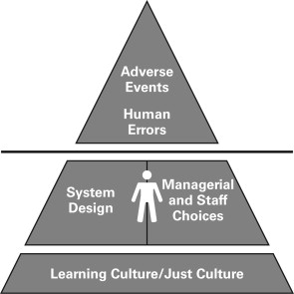
Just Culture: Balancing Accountability and Learning

Slide 10
Conclusion
Implementing a just, learning culture takes time and commitment. Overcoming barriers such as fear, poor communication, and lack of leadership buy-in is critical to building a resilient, high-performing organization.

Slide 11
References
- Kim, G., Humble, J., Debois, P., Willis, J., & Forsgren, N. (2021). The DevOps Handbook (2nd ed.). IT Revolution.
- Boysen, P. G., Dittus, R. S., & Dunn, A. S. (2016). “A Just Culture Approach to Quality Improvement.” Mayo Clinic.
- Dekker, S. (2012). Just Culture: Balancing Safety and Accountability. Ashgate Publishing.

Slide 12

THANK YOU

